Slide 1
Using Loops in Graphics
Notes:
Hi! In this lesson, we’re going to look at how loops can be implemented in our Python Graphics programs. Let’s go!

Slide 2
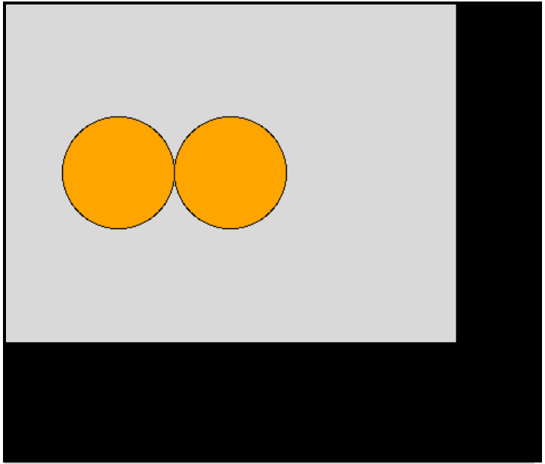
Loops in Python Graphics
from tkinter import *
root = Tk()
# Constant values
canvas_width = 400
canvas_height = 300
circle_position = 0
# Create canvas
screen = Canvas(root, width=canvas_width, height=canvas_height)
screen.pack()
for i in range (2):
top_x = 50 + circle_position
top_y = 100
bottom_x = 150 + circle_position
bottom_y = 200
screen.create_oval(top_x, top_y, bottom_x, bottom_y, fill="orange")
circle_position = circle_position + 100
mainloop()
Notes:
Using loops in Python graphics is exactly the same as using them in our console programs! We can define a for loop as shown here, where the number of times to repeat is noted inside parentheses. Indented inside we list all of the actions we want to be completed when we run the loop.

Slide 3
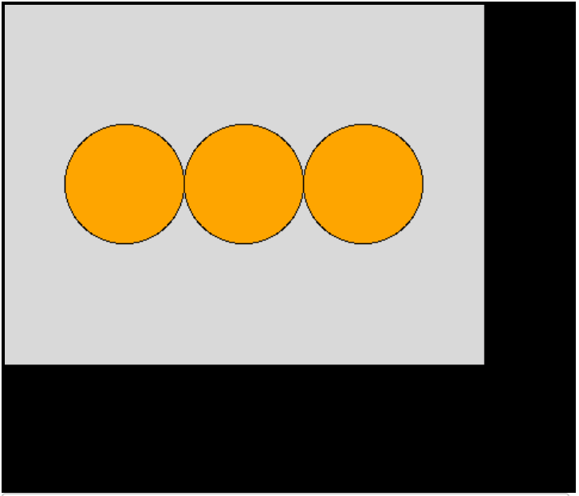
Loops in Python Graphics
from tkinter import *
root = Tk()
# Constant values
canvas_width = 400
canvas_height = 300
circle_position = 0
# Create canvas
screen = Canvas(root, width=canvas_width, height=canvas_height)
screen.pack()
for i in range (3):
top_x = 50 + circle_position
top_y = 100
bottom_x = 150 + circle_position
bottom_y = 200
screen.create_oval(top_x, top_y, bottom_x, bottom_y, fill="orange")
circle_position = circle_position + 100
mainloop()
Notes:
In this program, we can easily add more circles to the screen by altering the range of the loop. Let’s take a look at an example to see this in action.

Slide 4
Phone Signal
To create needed shapes:
screen.create_rectangle(top left x, top left y, bottom right x, bottom right y)
Constant Values:
canvas_width = 350
canvas_height = 350
bottom_base = 300
left_base = 50
bar_height = 50
bar_width = 30
Notes:
We’re going to complete this exercise where we’re being asked to draw 5 bars that differ in height and are spaced along the x-axis. Before we get to writing our program, let’s take a minute to plan.

Slide 5
Phone Signal
Constant Values:
canvas_width = 350 left_base = 50
canvas_height = 350 bar_height = 50
bottom_base = 300 bar_width = 30
To create needed shapes:
screen.create_rectangle(top left x, top left y, bottom right x, bottom right y)
Coordinate Points for Bar 1:
Top X: left_base
Top Y:
Bottom X:
Bottom Y:
left_base
Notes:
To get the x-coordinate point of the top corner of the first bar, we use the constant value of left_base that has been given to us.

Slide 6
Phone Signal
Constant Values:
canvas_width = 350 left_base = 50
canvas_height = 350 bar_height = 50
bottom_base = 300 bar_width = 30
To create needed shapes:
screen.create_rectangle(top left x, top left y, bottom right x, bottom right y)
Coordinate Points for Bar 1:
Top X: left_base
Top Y: bottom_base - bar_height
Bottom X:
Bottom Y:
bottom_base - bar_height
Notes:
To get the y-coordinate point of the top corner of the first bar, we start with the bottom_base variable and subtract the bar_height value. Remember! Y values decrease as the vertical position gets higher on the canvas which is why we subtract the bar_height variable rather than add it.

Slide 7
Phone Signal
Constant Values:
canvas_width = 350 left_base = 50
canvas_height = 350 bar_height = 50
bottom_base = 300 bar_width = 30
To create needed shapes:
screen.create_rectangle(top left x, top left y, bottom right x, bottom right y)
Coordinate Points for Bar 1:
Top X: left_base
Top Y: bottom_base - bar_height
Bottom X: left_base + bar_width
Bottom Y:
left_base + bar_width
Notes:
To get the x-coordinate point of the bottom corner of the first bar, we use the constant value of left_base that has been given to us and add the bar_width variable.

Slide 8
Phone Signal
Constant Values:
canvas_width = 350 left_base = 50
canvas_height = 350 bar_height = 50
bottom_base = 300 bar_width = 30
To create needed shapes:
screen.create_rectangle(top left x, top left y, bottom right x, bottom right y)
Coordinate Points for Bar 1:
Top X: left_base
Top Y: bottom_base - bar_height
Bottom X: left_base + bar_width
Bottom Y: bottom_base
bottom_base
Notes:
For the y-coordinate of the bottom corner of the first bar, we just use the bottom_base value. Now how will these values change after each bar is drawn?

Slide 9
Phone Signal
Constant Values:
canvas_width = 350 left_base = 50
canvas_height = 350 bar_height = 50
bottom_base = 300 bar_width = 30
To create needed shapes:
screen.create_rectangle(top left x, top left y, bottom right x, bottom right y)
Changing variable values:
left_base = left_base + 50
+50
50 100 150 200 250
Notes:
The left_base variable must increase by 50 on each loop in order to align the bars horizontally.

Slide 10
Phone Signal
Constant Values:
canvas_width = 350 left_base = 50
canvas_height = 350 bar_height = 50
bottom_base = 300 bar_width = 30
To create needed shapes:
screen.create_rectangle(top left x, top left y, bottom right x, bottom right y)
250
Changing variable values:
left_base = left_base + 50
bar_height = bar_height + 50
200
+50
150
100
50
Notes:
The bar_height variable also need to increase by 50 on each iteration. Okay, let’s write this in the editor.

